Slide 1
Big O Complexity
Sai Kishan Talamarla

Slide 2
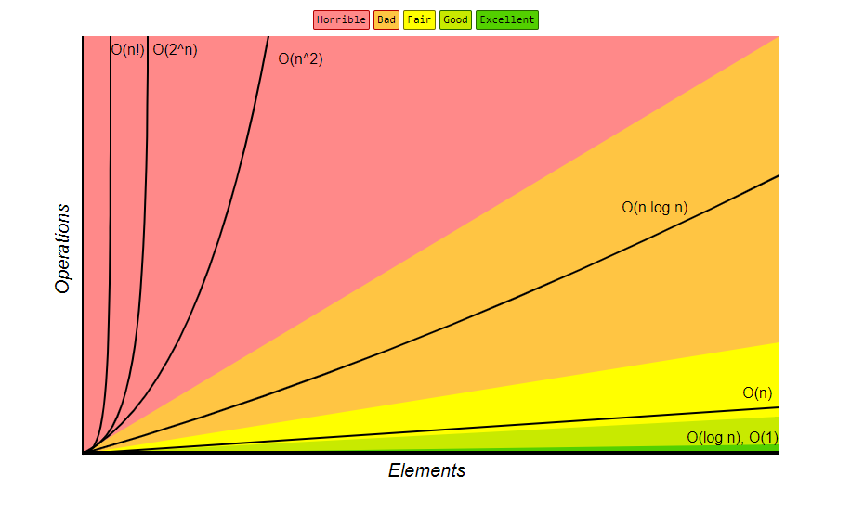
Big 0 Complexity Chart

Slide 3
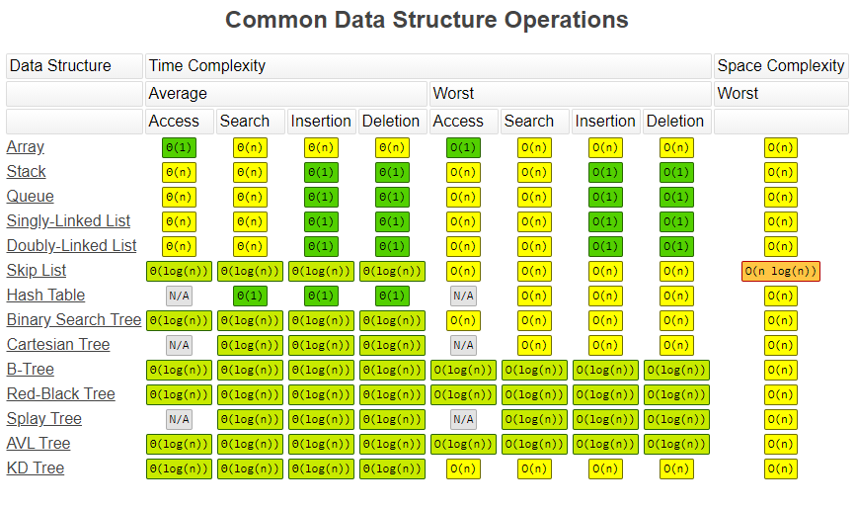

Slide 4
